Slide 1

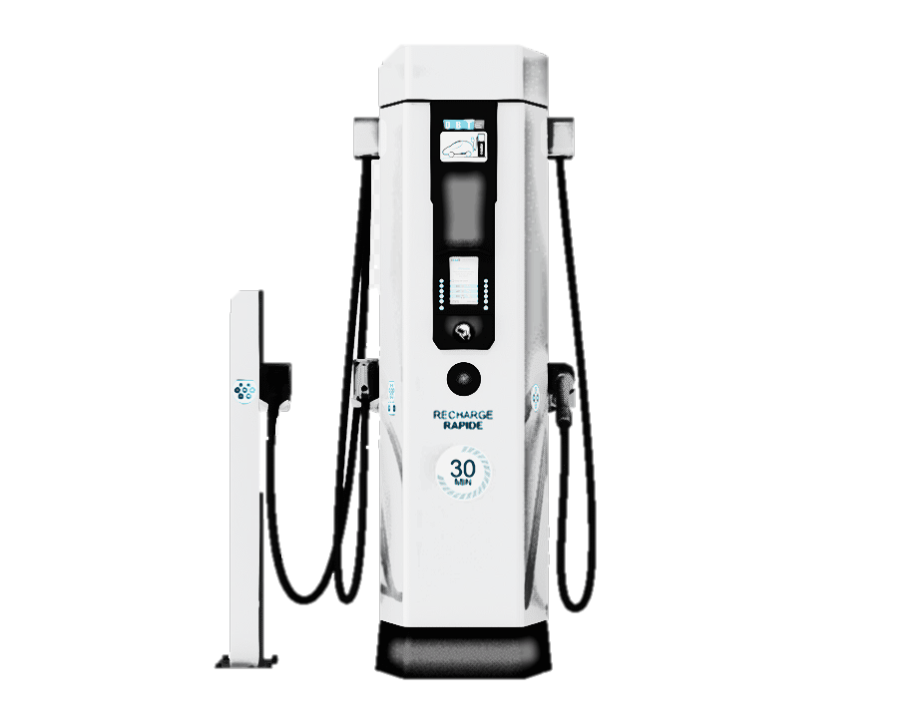
HYBRID CHARGING STATION
Presented By
CHARAN .D - CB.EN.U4EEE20014
K.RAMESH NAIDU - CB.EN.U4EEE20028
N. RAJITHA KIRANMAI-CB.EN.U4EEE20034
Sai Pranay T- CB.EN.U4EEE20045
Guide:
Dr. S Parvathy
Assistant Professor

Slide 2
CONTENTS
Introduction
Literature survey
Summary
System specifications
Objective
Block diagram
Design

Slide 3
CONTENTS
Graphs
Simulation
Inference
Work in progress
Conclusion
Time Frame
Reference

Slide 4
INTRODUCTION
In an era characterized by the pressing need for sustainable solutions, the Hybrid Charging Station project emerges as a visionary endeavor poised to revolutionize the way we power our vehicles.
The Hybrid Charging Station project envisions a cutting-edge infrastructure that seamlessly merges the capabilities of traditional fossil fuels with the promising potential of electric power.

Slide 5

OBJECTIVE
The objective of this project is to design and implement an hybrid electric vehicle (EV) charging system that combines solar power and grid connectivity.

Slide 6
LITERATURE SURVEY
TITLE ,AUTHOR | PUBLICATION | YEAR | ABSTRACT
G. . T. S. Rajan, V. Sivachidambaranathan, A. R. Babu, A. S. M. Antony, J. B. P. Glady and S. D. Sundarsingh Jebaseelan, "Hybrid Grid Charging Station for Electric Vehicle Using IoT," 2023 International Conference on Intelligent and Innovative Technologies in Computing, Electrical and Electronics (IITCEE), Bengaluru, India, 2023, pp. 528-532 | IEEE | 2023 | Hybrid grid charging station for electric vehicles, utilizing both solar and grid power sources, with an emphasis on energy efficiency and weather-based charging source selection.
E. . Saleh and N. Karami, "A Fast and Efficient MPPT Technique For PV Systems Using Divide and Conquer," 2023 Advances in Science and Engineering Technology International Conferences (ASET), Dubai, United Arab Emirates, 2023, pp. 01-06 | ASET | 2023 | Novel MPPT method uses Divide and Conquer search algorithm, outperforming traditional Perturb and Observe (P&O) technique in efficiency and tracking speed.
R. . Madhumitha, P. Priya and S. Saravanan, "Hybrid Renewable Energy Based Electric Vehicles Charging Station," 2022 2nd International Conference on Advance Computing and Innovative Technologies in Engineering (ICACITE), Greater Noida, India, 2022, pp. 2348-2352 | IEEE | 2022 | EV charging station model using hybrid renewable energy sources to address grid stress and promote sustainability.

Slide 7
LITERATURE SURVEY
TITLE ,AUTHOR | PUBLICATION | YEAR | Abstract
A.Safaeinasab, H. S. Gohari and K. Abbaszadeh, "Design and Control of a Novel Multi-port Bidirectional Buck-Boost Converter Suitable for Hybrid Electric Vehicle Charging Stations," 2022 30th International Conference on Electrical Engineering (ICEE), Tehran, Iran, Islamic Republic of, 2022, pp. 1027-1032 | IEEE | 2022 | This paper presents a novel multi-port bidirectional converter for wind, solar, and EV charging stations, featuring various operating modes and a cascade linear controller for voltage stabilization. Simulation in MATLAB validates the system.
K. . S. Vikas, B. Raviteja Reddy, S. G. Abijith and M. R. Sindhu, "Controller for Charging Electric Vehicles at Workplaces using Solar Energy," 2019 International Conference on Communication and Signal Processing (ICCSP), Chennai, India, 2019, pp. 0862-0866 | IEEE | 2019 | Solar-integrated EV charging station designed and implemented, can charge 2 EVs in 7 hours even with intermittent solar power.
S. Palanidoss and T. V. S. Vishnu, "Experimental analysis of conventional buck and boost converter with integrated dual output converter," 2017 International Conference on Electrical, Electronics, Communication, Computer, and Optimization Techniques (ICEECCOT), Mysuru, India, 2017, pp. 323-329 | IEEE | 2017 | Designing a buck converter involves stepping down voltage, while a boost converter increases voltage, both essential for power conversion applications.

Slide 8
SUMMARY
hybrid grid EV charging station integrates solar and grid power for energy efficiency.
A buck converter steps down voltage, while a boost converter increases voltage. These converters play a crucial role in power conversion applications, ensuring compatibility and efficient energy transfer.
The EV charging station model harnesses hybrid renewable energy sources to mitigate grid stress and promote sustainability, addressing the increasing demand for electric vehicle charging.
MPPT is crucial for extracting the maximum available energy from the solar panels.

Slide 9
OVERVIEW OF REVIEW-1
Design of three phase rectifier
Design of Buck converter
Design of bidirectional buckboost converter

Slide 10
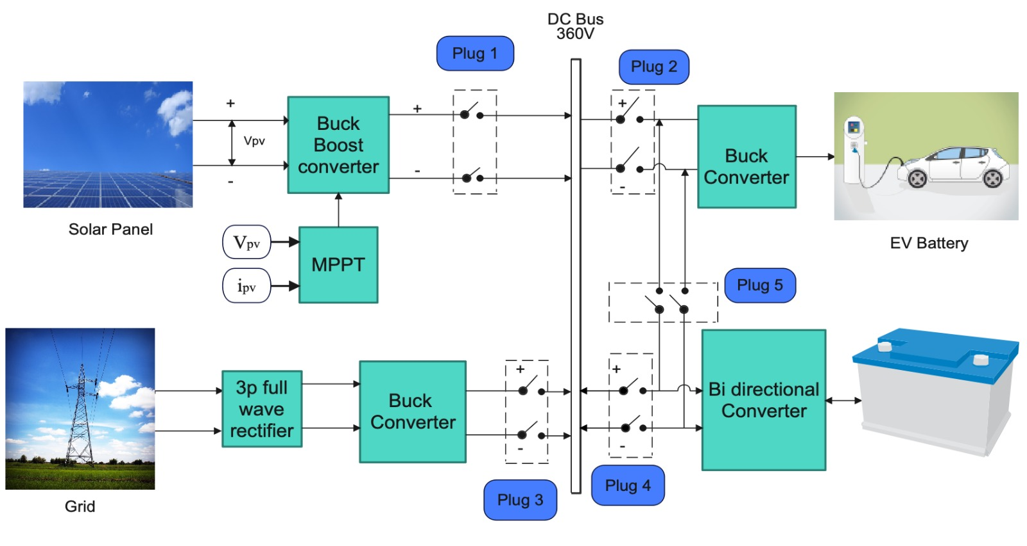
BLOCK DIAGRAM :

Slide 11
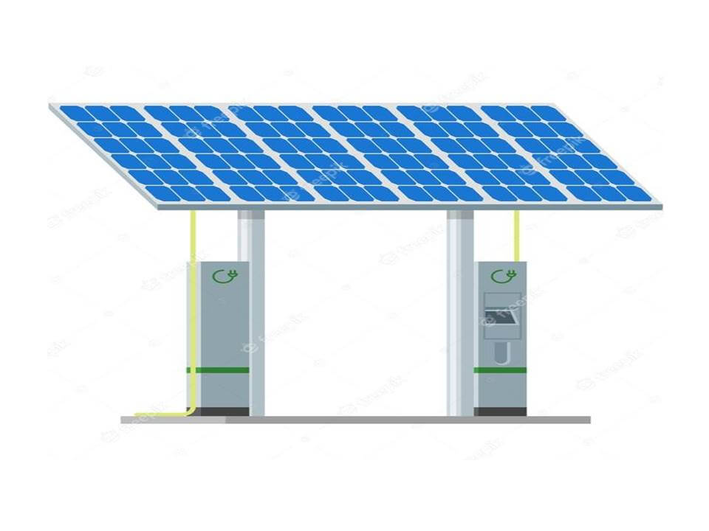
SOLAR PANEL
A solar panel is a device that converts sunlight into electricity by using photovoltaic (PV) cells. The flow of a circuit and produce direct circuit (DC) electricity, which can be used to power various devices or be stored in batteries. Solar panels are also known as solar cell panels, solar electric panels, or PV modules.
SOLAR PANEL DESIGN
OCC Voltage= 36.3V
SCC Voltage= 7.84A
V_mp= 30V
I_mp= 7.35A
Parallel string = 10
Series string = 15
A10J-M60-220-A10Green-Technology

Slide 12
MAXIMUM POWER POINT TRACKING (MPPT)
Incremental Conductance: It calculates the derivative of the power-voltage curve and adjusts the operating point accordingly.
CONSTANT VOLTAGE :
The output voltage is regulated to a constant value under all conditions and one in which the output voltage is regulated based on a constant ratio to the measured open circuit voltage
Perturb and Observe (P&O): This method periodically adjusts the operating point and observes the impact on power output.
MPPT Techniques
MPPT stands for Maximum Power Point Tracking, and it refers to techniques used in solar inverters to optimize the power output from solar panels.
MPPT is a technology used in solar inverters to maximize the power output from solar panels by adjusting the operating point of the photovoltaic system.

Slide 13
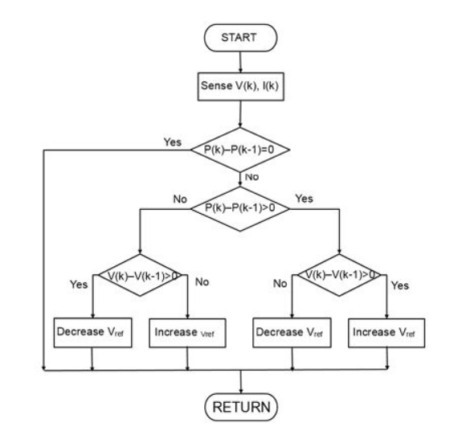
CONSTANT VOLTAGE METHOD
A constant voltage is a basic PO MPPT algorithm that automatically adjusts the reference voltage to account for varying environmental conditions is presented. A simple (and inexpensive) analog feedforward PWM controller is developed to continuously track the MPP of a solar cell array as the weather conditions vary. The solar array source is configured such that its open-circuit voltage is sampled without breaking the entire source from the load as is the case with other constant voltage MPP algorithms.

Slide 15
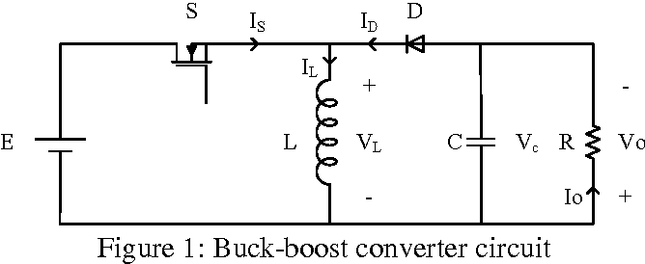
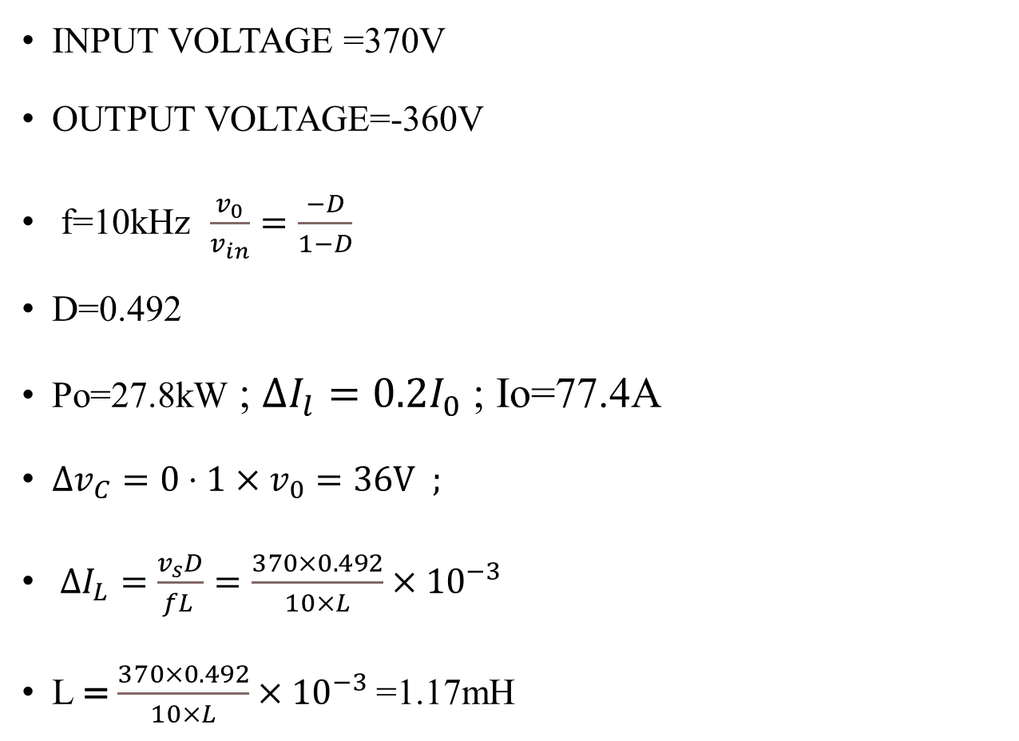
BUCK BOOST CONVERTER
INPUT VOLTAGE =370V
OUTPUT VOLTAGE=-360V
f=10kHz $\frac{v_{0}}{v_{in}}=\frac{−D}{1−D}$
D=0.492
Po=27.8kW ; $ΔI_{l}=0.2I_{0}$ ; Io=77.4A
$Δv_{C}=0⋅1×v_{0}=36V ;$
$ΔI_{L}=\frac{v_{s}D}{fL }=\frac{370×0.492}{10×L}×{10}^{−3}$
L = $\frac{370×0.492}{10×L}×{10}^{−3}$=1.17mH

Slide 16
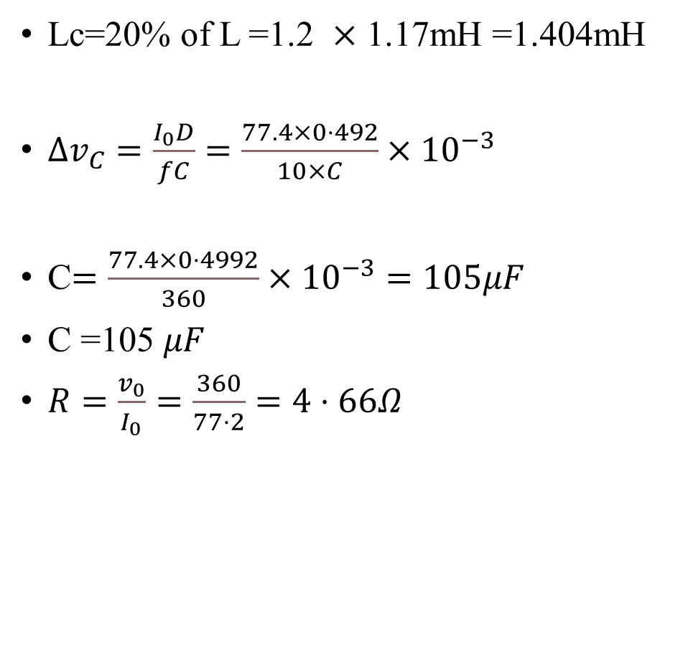
BUCK BOOST CONVERTER
Lc=20% of L =1.2 $×$ 1.17mH =1.404mH
$Δv_{C}=\frac{I_{0}D}{fC}=\frac{77.4×0⋅492}{10×C}×{10}^{−3}$
C$=\frac{77.4×0⋅4992}{360}×{10}^{−3}=105μF$
C =105 $μF$
$R=\frac{v_{0}}{I_{0}}=\frac{360}{77⋅2}=4⋅66Ω$

Slide 17
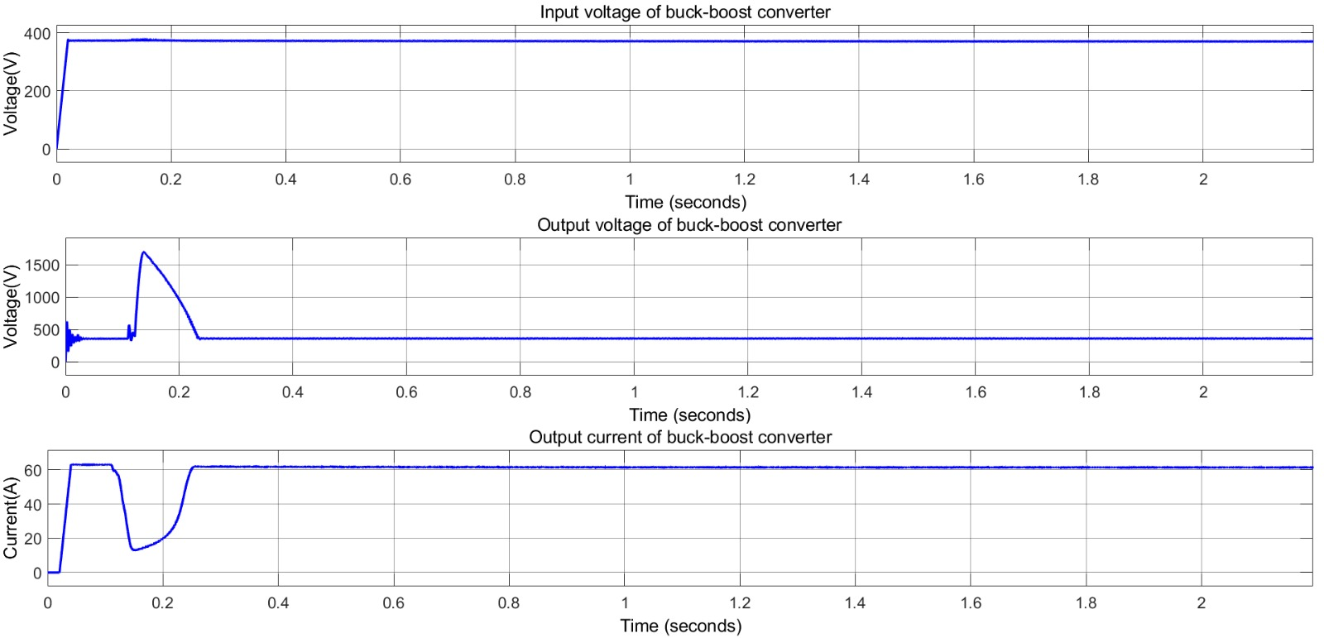
VOLTAGE AND CURRENT WAVEFORM OF BUCK BOOST CONVERTER

Slide 18
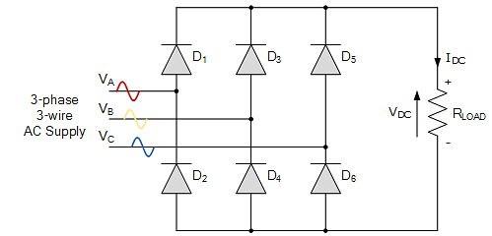
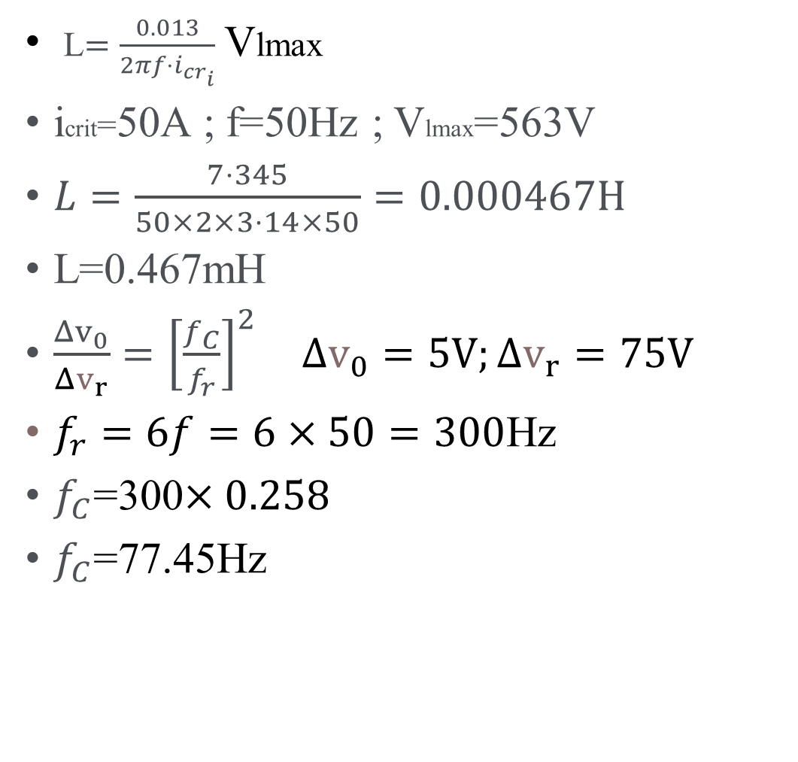
DESIGN OF 3 PHASE RECTIFIER
L$=\frac{0.013}{2πf⋅i_{cr_{i}}}$ Vlmax
icrit=50A ; f=50Hz ; Vlmax=563V
$L=\frac{7⋅345}{50×2×3⋅14×50}=0.000467H$
L=0.467mH
$\frac{Δv_{0}}{Δv_{r}}={\left[\frac{f_{C}}{f_{r}}\right]}^{2}$ $Δv_{0}=5V;Δv_{r}=75V$
$f_{r}=6f=6×50=300$Hz
$f_{C}$=300$×0.258$
$f_{C}$=77.45Hz

Slide 19

DESIGN OF 3 PHASE RECTIFIER
Cout$=\frac{1}{4⋅\text{π}\text{.}\text{π}f.f.L}$= $\frac{1000}{4×5998.5025×0.467×9.8}$
Cout=905.15 $μF$

Slide 20
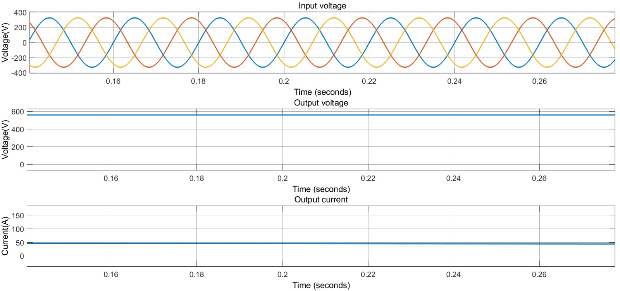
VOLTAGE & CURRENT WAVE FORMS OF A 3- PHASE RECTIFIER

Slide 21
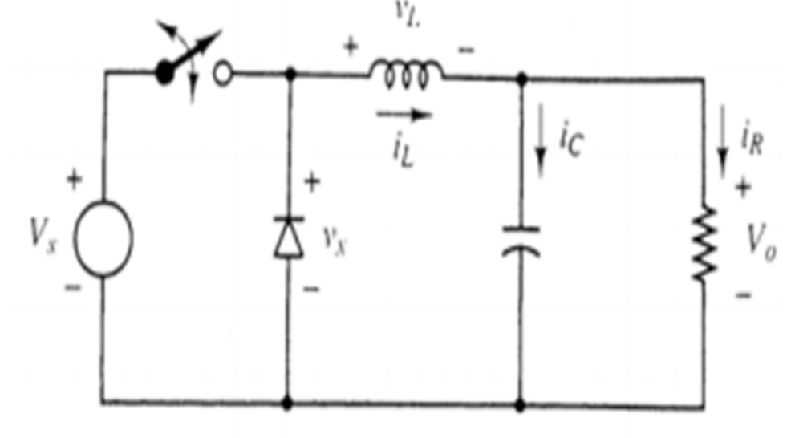
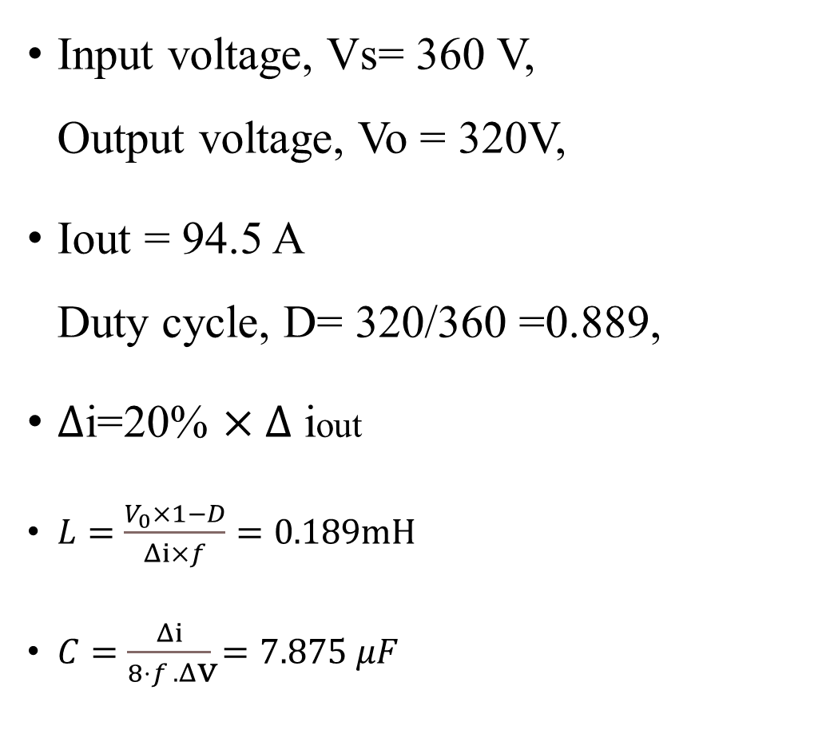
DESIGN OF BUCK CONVERTER
Input voltage, Vs= 360 V, Output voltage, Vo = 320V,
Iout = 94.5 A Duty cycle, D= 320/360 =0.889,
$∆$i=20% $×∆$ iout
$L=\frac{V_{0}×1−D}{Δⅈ×f}=0.189mH$
$C=\frac{Δⅈ}{8⋅f .Δ\text{v}}=7.875$ $μF$

Slide 22
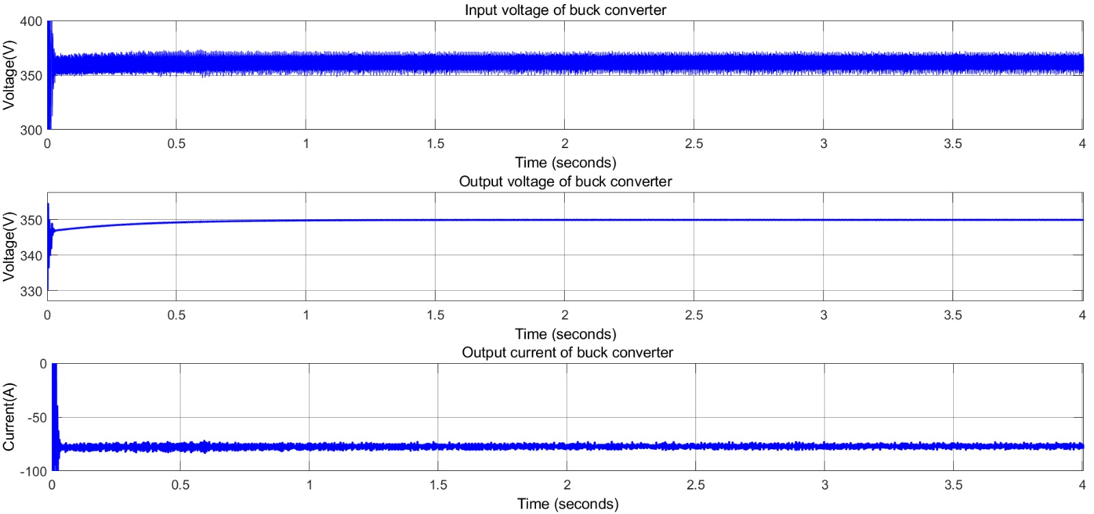
VOLTAGE &CUTTENT WAVE FORMS BUCK CONVERTER GRAPHS

Slide 23
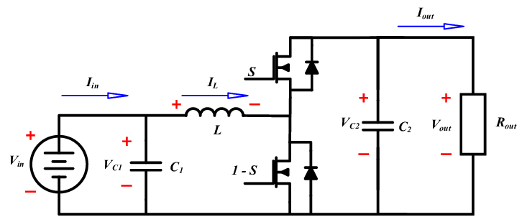
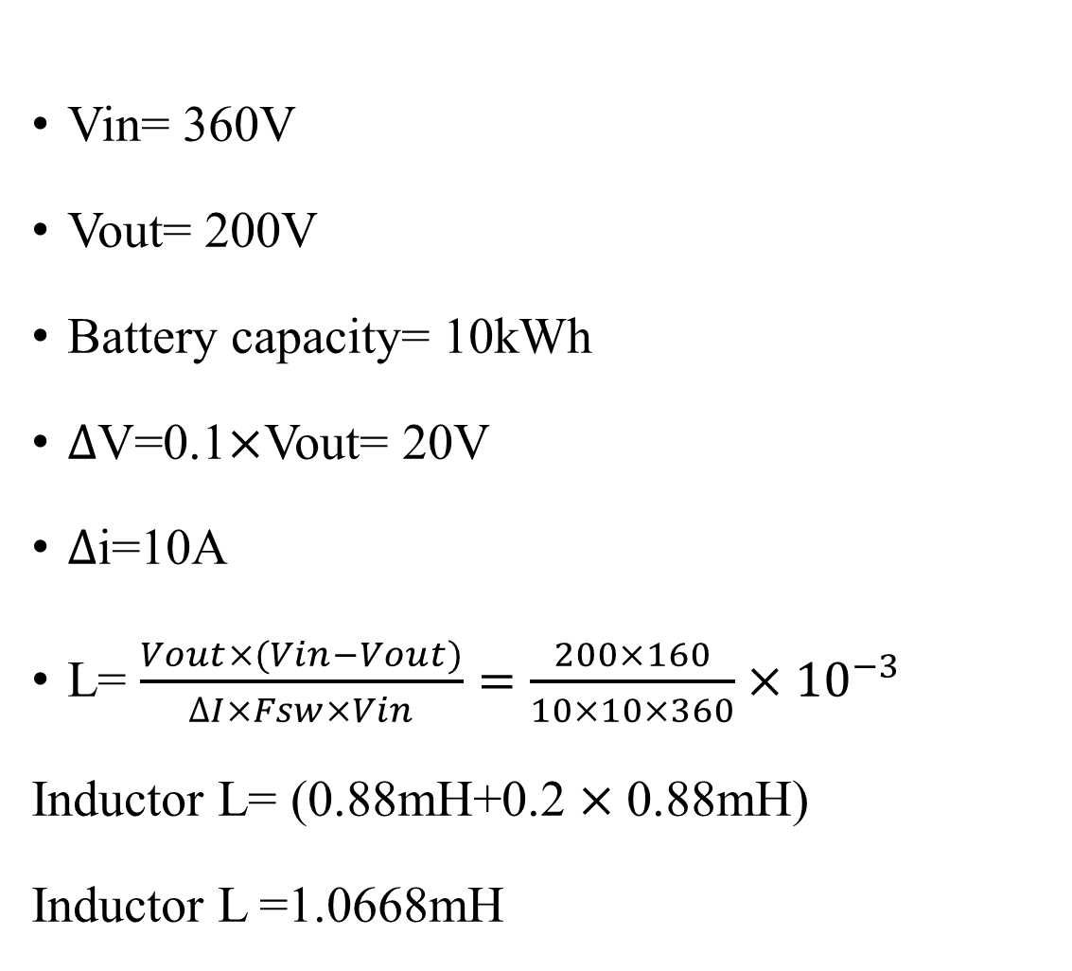
DESIGN OF BI-DIRECTIONAL CONVERTER
Vin= 360V
Vout= 200V
Battery capacity= 10kWh
$∆$V=0.1$×$Vout= 20V
$∆$i=10A
L= $\frac{Vout×(Vin−Vout)}{∆I×Fsw×Vin}=\frac{200×160}{10×10×360}×{10}^{−3}$
Inductor L= (0.88mH+0.2 $×\text{0}\text{.}\text{88}\text{mH}\text{)}$
Inductor L =1.0668mH

Slide 24
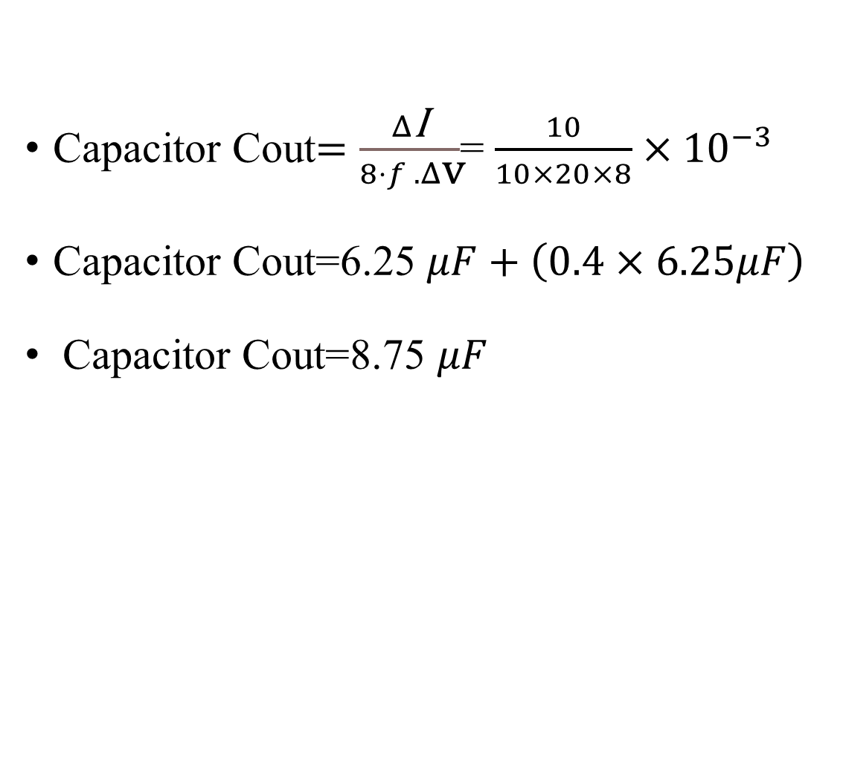
DESIGN OF BI-DIRECTIONAL CONVERTER
Capacitor Cout$=\frac{Δ\text{I}}{8⋅f .Δ\text{v}}$= $\frac{10}{10×20×8}×{10}^{−3}$
Capacitor Cout=6.25 $μF+\left(0.4×6.25μF\right)$
Capacitor Cout=8.75 $μF$

Slide 25
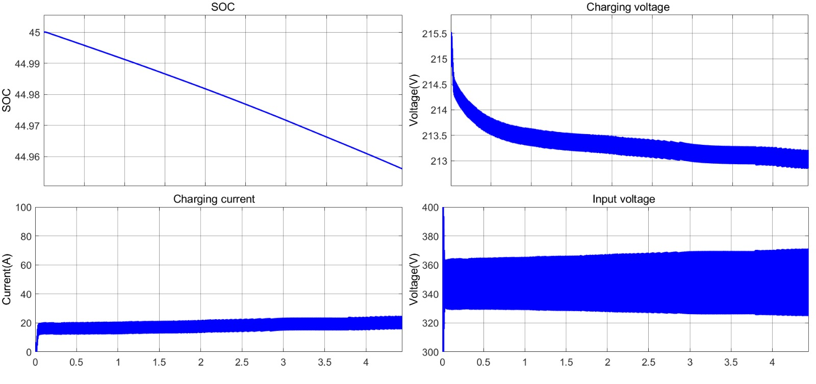
BI-DIRECTIONAL CONVERTER GRAPHS WHEN CURRENT IS DISCHARGING

Slide 26
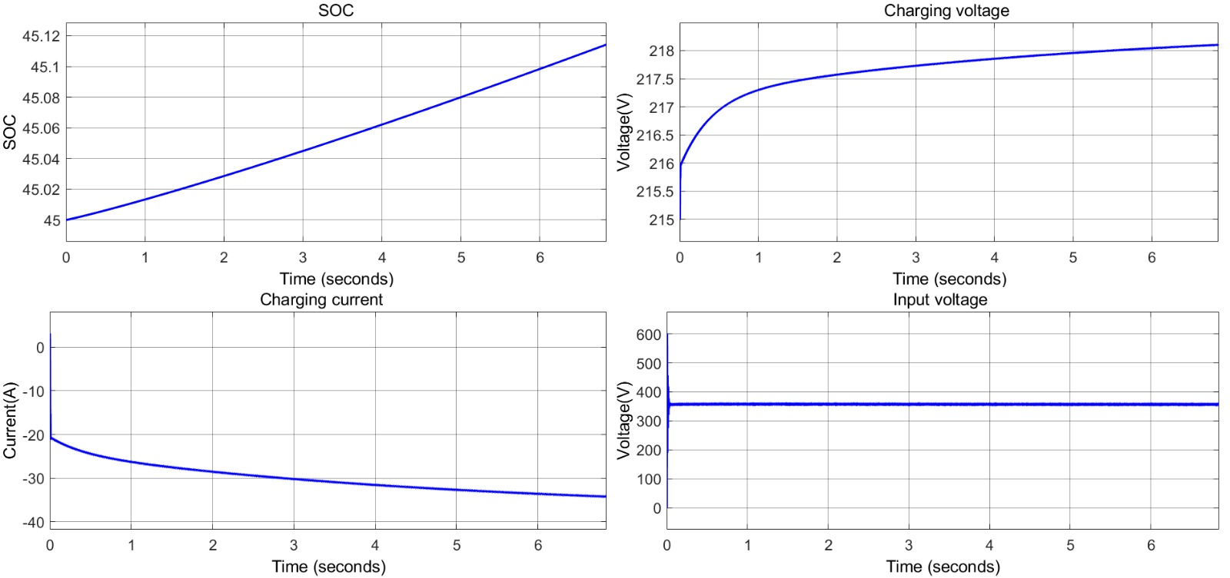
BI-DIRECTIONAL CONVERTER GRAPHS WHEN CURRENT IS CHARGING

Slide 27
SYSTEM SPECIFICATIONS
SYSTEM SPECIFICATION | RATING | QUANTITY
SOLAR PANEL | 370V 33.07kW | 1
BUCK –BOOST CONVERTER | 370/360V 33.075 KW | 1
THREE-PHASE RECTIFIER | 398.36/563V 29kW | 1
BUCK CONVERTER | 563V/360V ; 29kW 360/320V ; 29kW | 2
Bi- DIRECTIONAL CONVERTER | 360/200V ;10kW | 1
CAR BATTERY | 320V ;94.5Ah | 1
BACK UP BATTERY | 200V;50Ah | 1

Slide 28
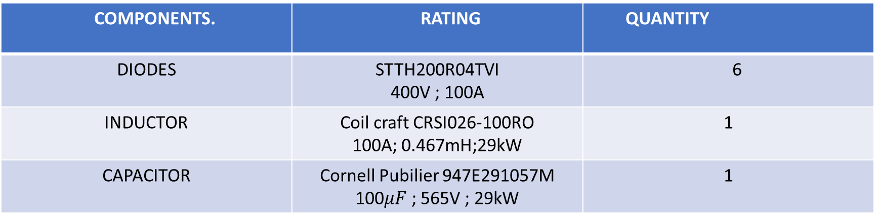
SYSTEM SPECIFICATIONS OF 3- PHASE RECTIFIER
COMPONENTS. | RATING | QUANTITY
DIODES | STTH200R04TVI 400V ; 100A | 6
INDUCTOR | Coil craft CRSI026-100RO 100A; 0.467mH;29kW | 1
CAPACITOR | Cornell Pubilier 947E291057M 100$μF$ ; 565V ; 29kW | 1
SYSTEM SPECIFICATIONS OF BUCK CONVERTER NEAR GRID
COMPONENTS. | QUANTITY
DIODE | 1
MOSFET | 1
CAPACITOR | 1
INDUCTOR | 1

Slide 29
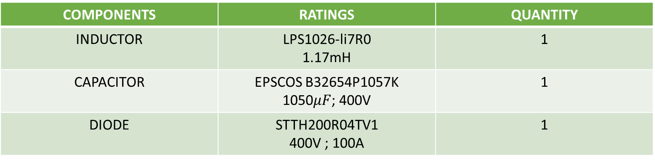
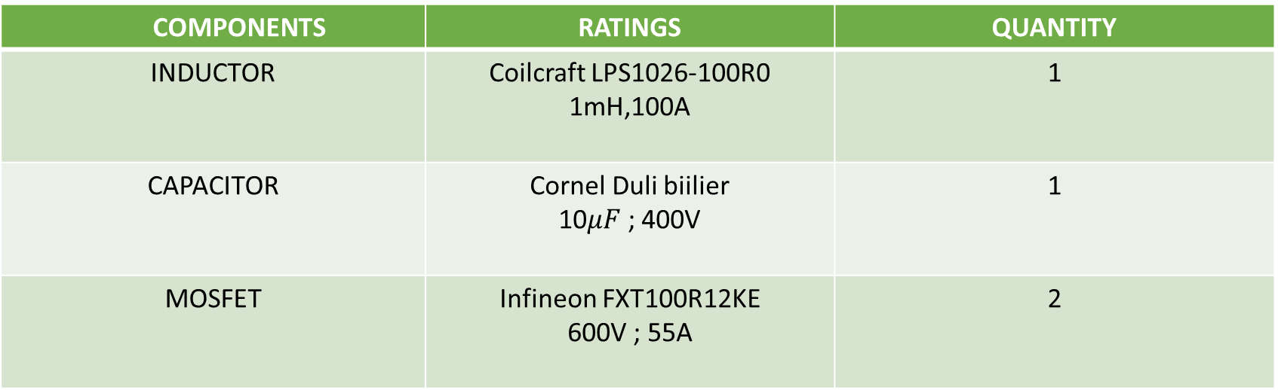
SYSTEM SPECIFICATIONS OF BI DIRECTIONAL CONVERTER
COMPONENTS | RATINGS | QUANTITY
INDUCTOR | Coilcraft LPS1026-100R0 1mH,100A | 1
CAPACITOR | Cornel Duli biilier 10$μF$ ; 400V | 1
MOSFET | Infineon FXT100R12KE 600V ; 55A | 2
SYSTEM SPECIFICATIONS OF BUCK-BOOST CONVERTER
COMPONENTS | RATINGS | QUANTITY
INDUCTOR | LPS1026-li7R0 1.17mH | 1
CAPACITOR | EPSCOS B32654P1057K 1050$μF$; 400V | 1
DIODE | STTH200R04TV1 400V ; 100A | 1

Slide 30
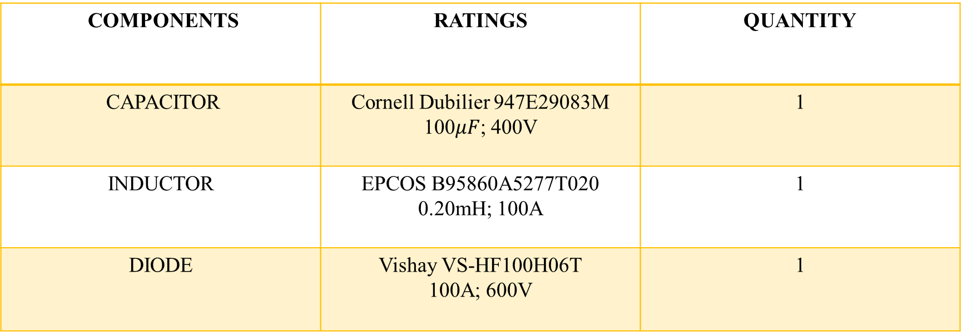
SYSTEM SPECIFICATIONS OF BUCK CONVERTER
COMPONENTS | RATINGS | QUANTITY
CAPACITOR | Cornell Dubilier 947E29083M 100$μF$; 400V | 1
INDUCTOR | EPCOS B95860A5277T020 0.20mH; 100A | 1
DIODE | Vishay VS-HF100H06T 100A; 600V | 1

Slide 31
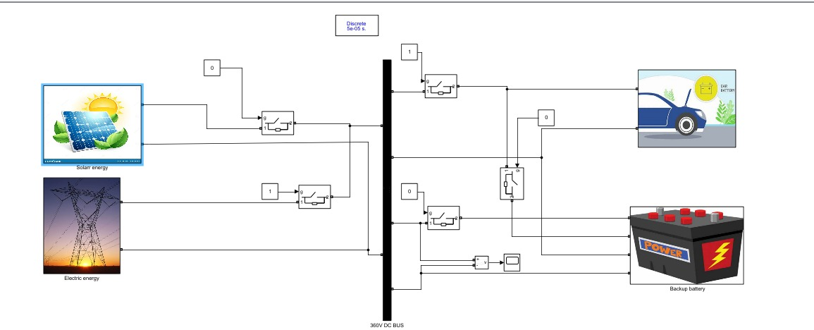
SIMULATION OVERVIEW

Slide 32
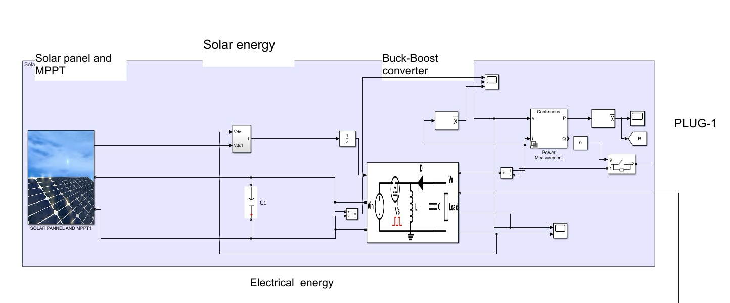
SOLAR SUBSYSTEM

Slide 33
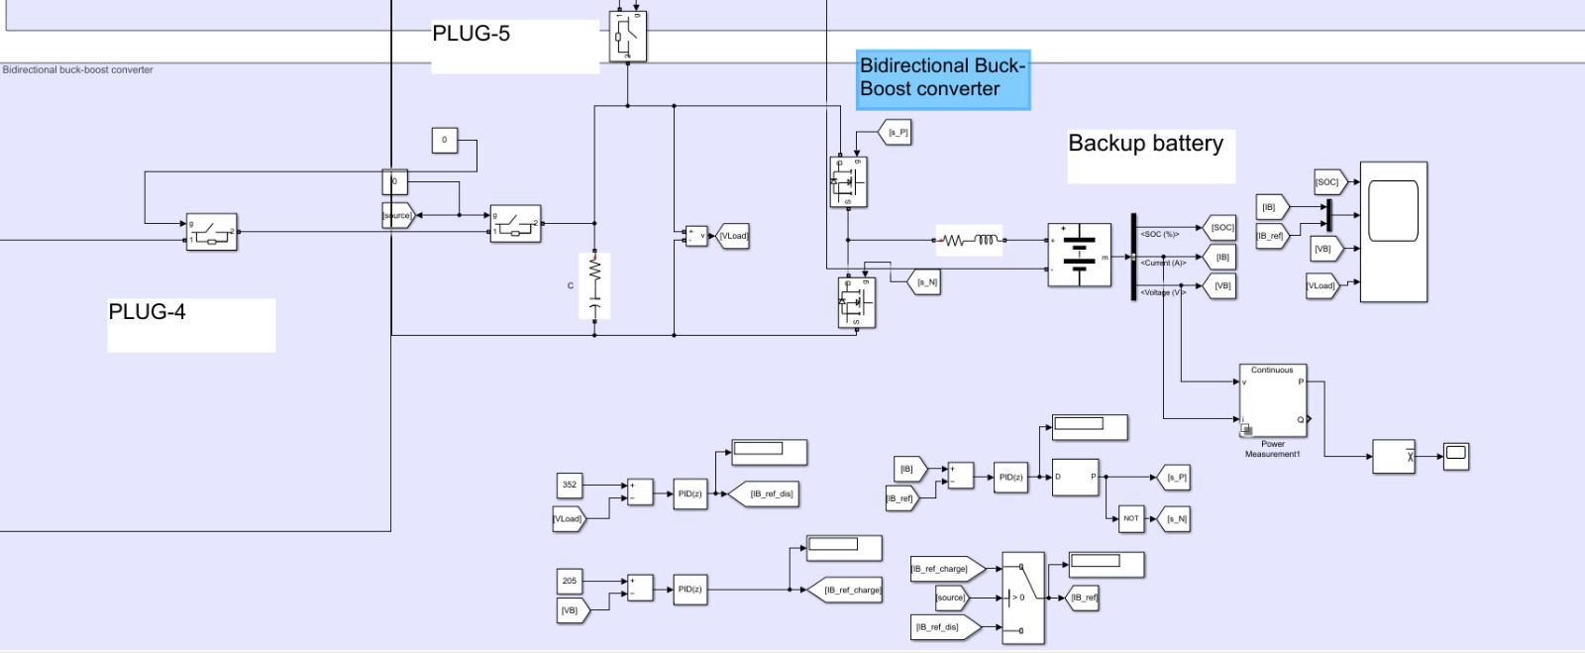
BACK UP STORAGE SUBSYSTEM

Slide 34
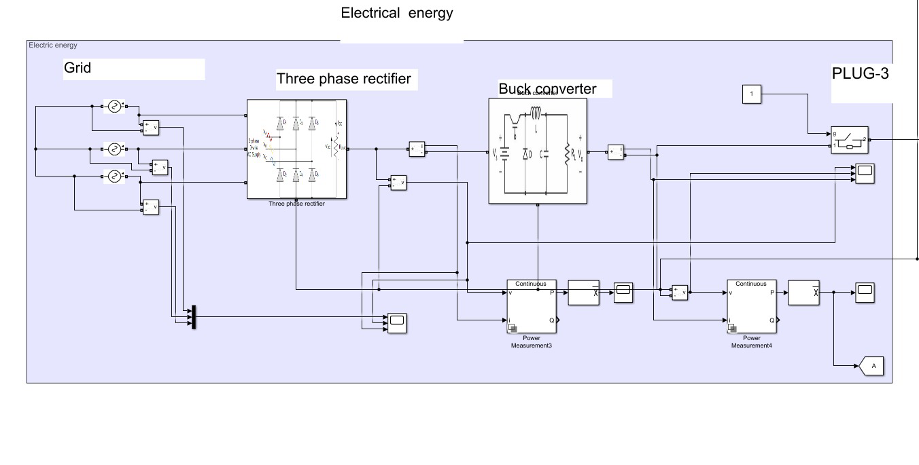
GRID SUBSYSTEM

Slide 35
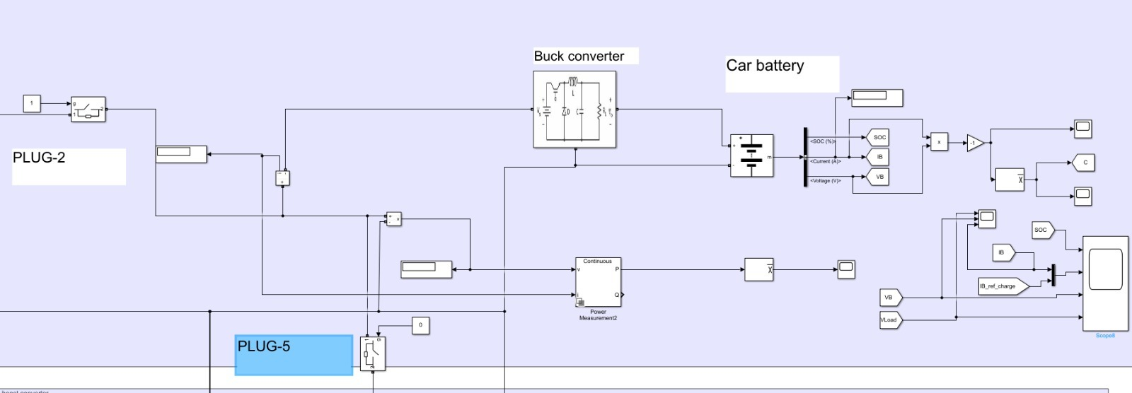
EV SUBSYSTEM

Slide 36
MODE OF OPERATION

Slide 37
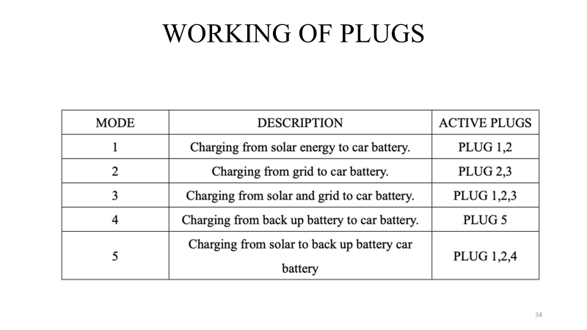
BLOCK DIAGRAM

Slide 38
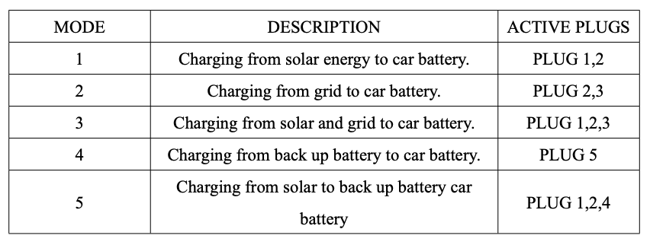
WORKING OF PLUGS

Slide 39
MODE 1-SOLAR PANEL TO EV BATTERY

Slide 40

MODE 1-SOLAR PANEL TO EV BATTERY

Slide 41

MODE 1-SOLAR PANEL TO EV BATTERY

Slide 42
MODE 1-SOLAR PANEL TO EV BATTERY

Slide 43
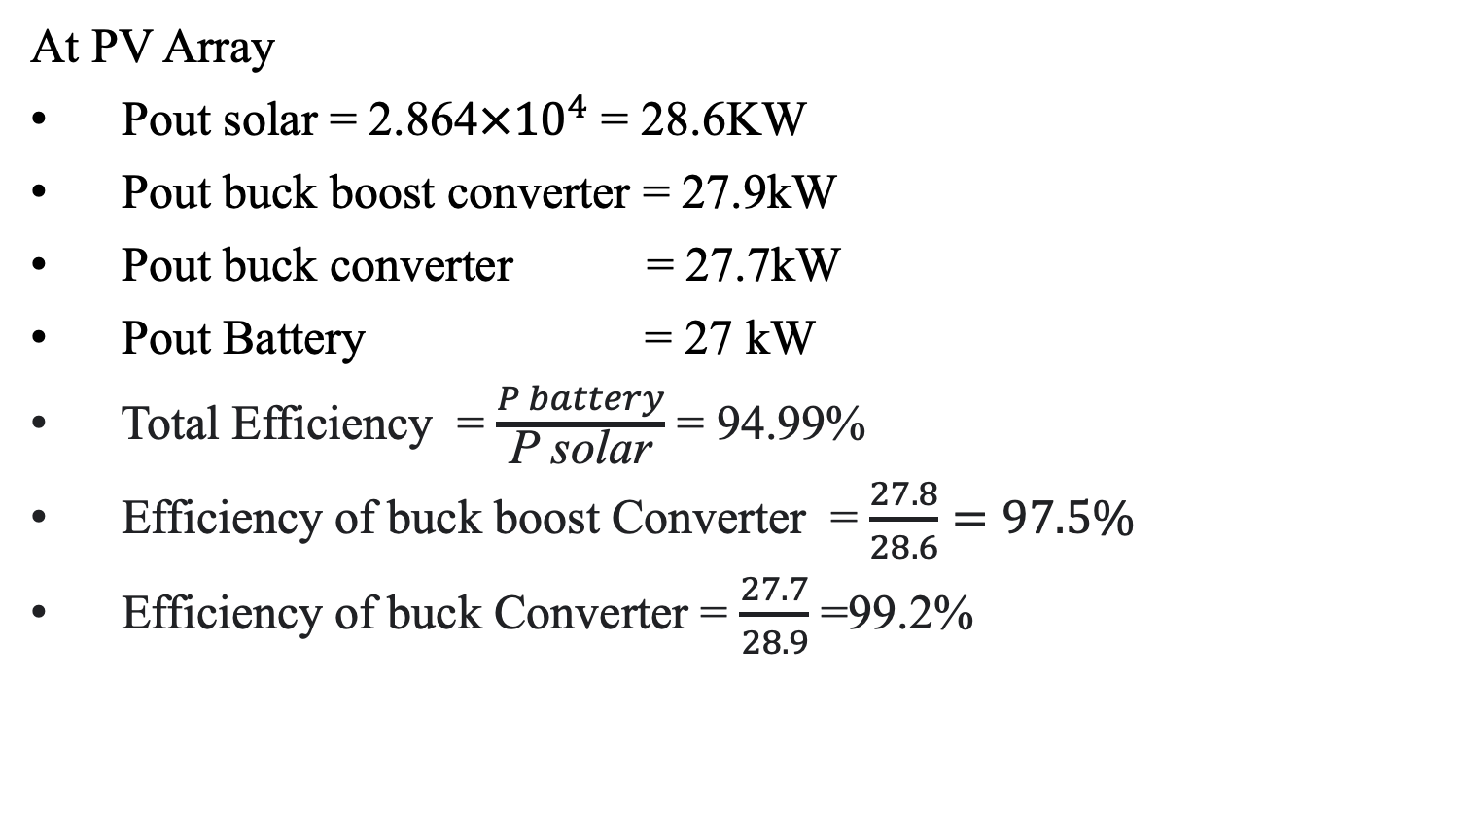
MODE 1-SOLAR PANEL TO EV BATTERY
At PV Array
Pout solar = 2.864$×{10}^{4}$ = 28.6KW
Pout buck boost converter = 27.9kW
Pout buck converter = 27.7kW
Pout Battery = 27 kW
Total Efficiency = $\frac{P battery}{\text{P} \text{solar}}$ = 94.99%
Efficiency of buck boost Converter = $\frac{27.8}{28.6}=97.5\%$
Efficiency of buck Converter = $\frac{27.7}{28.9}$ =99.2%

Slide 44
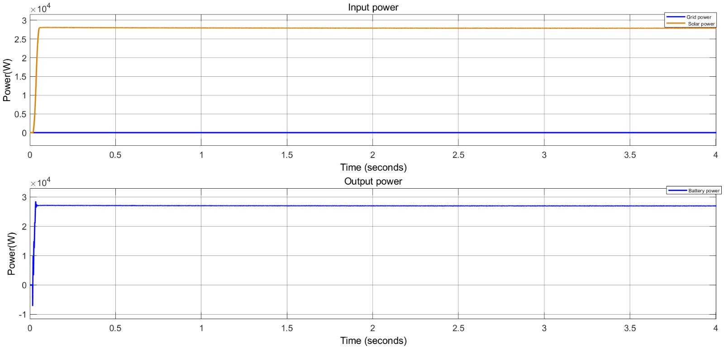
POWER GRAPHS OF MODE-1

Slide 45
MODE-2 GRID TO EV BATTERY

Slide 46
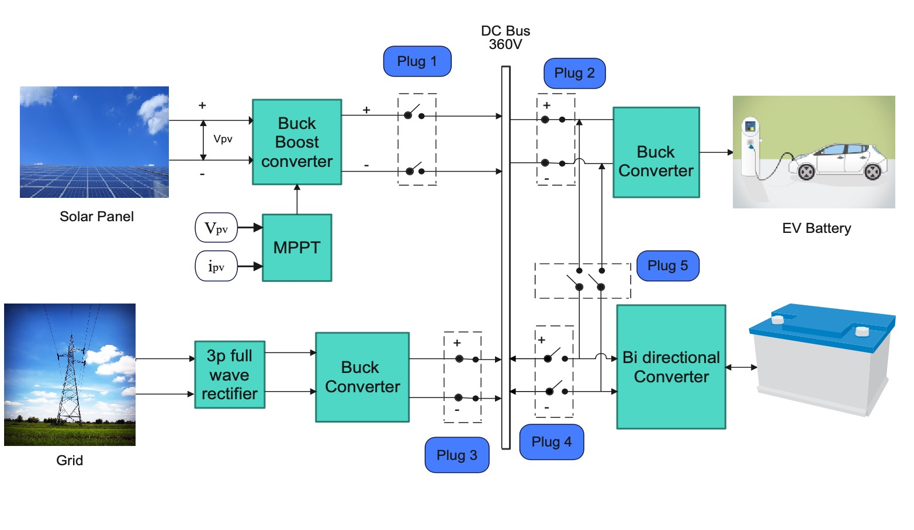
MODE-2 GRID TO EV BATTERY

Slide 47
MODE-2 GRID TO EV BATTERY

Slide 48
MODE-2 GRID TO EV BATTERY

Slide 49
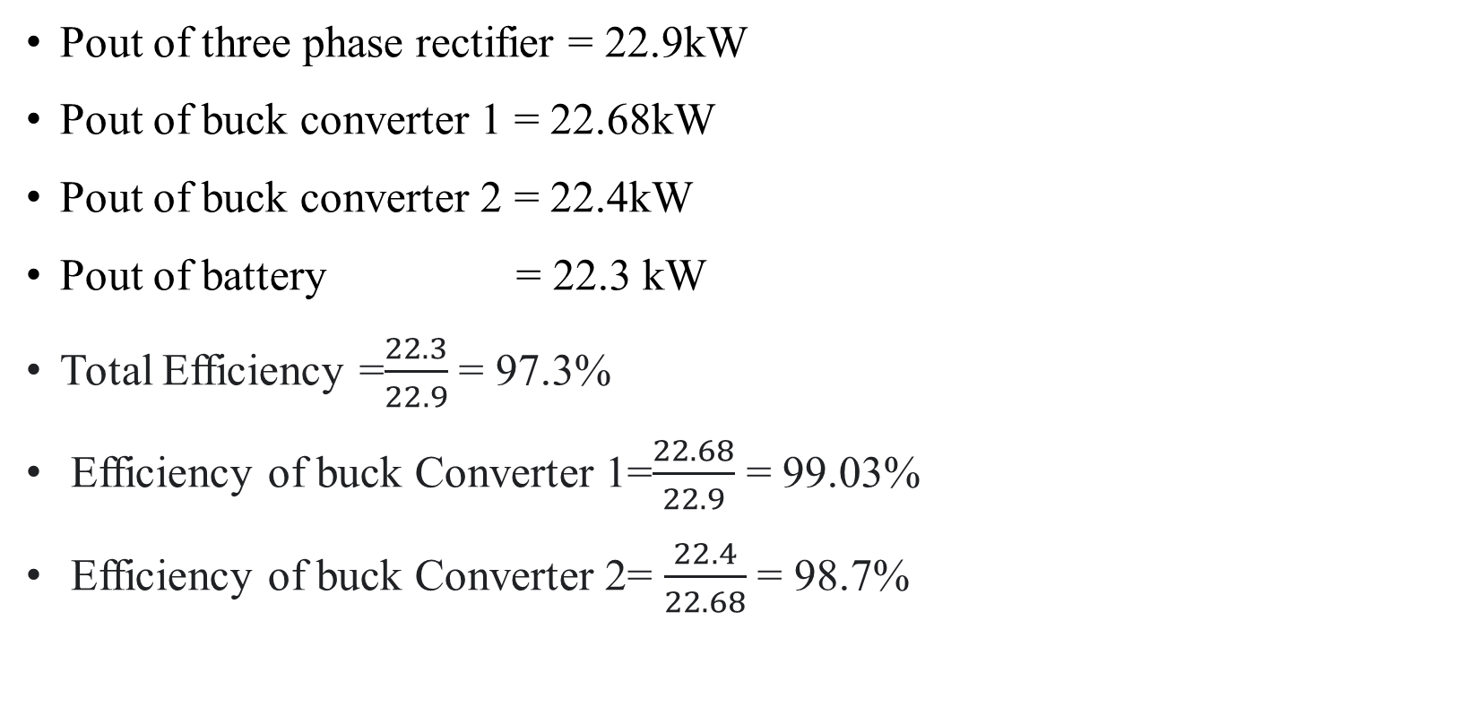
MODE-2 GRID TO EV BATTERY
Pout of three phase rectifier = 22.9kW
Pout of buck converter 1 = 22.68kW
Pout of buck converter 2 = 22.4kW
Pout of battery = 22.3 kW
Total Efficiency =$\frac{22.3}{22.9}$ = 97.3%
Efficiency of buck Converter 1=$\frac{22.68}{22.9}$ = 99.03%
Efficiency of buck Converter 2= $\frac{22.4}{22.68}$ = 98.7%

Slide 50
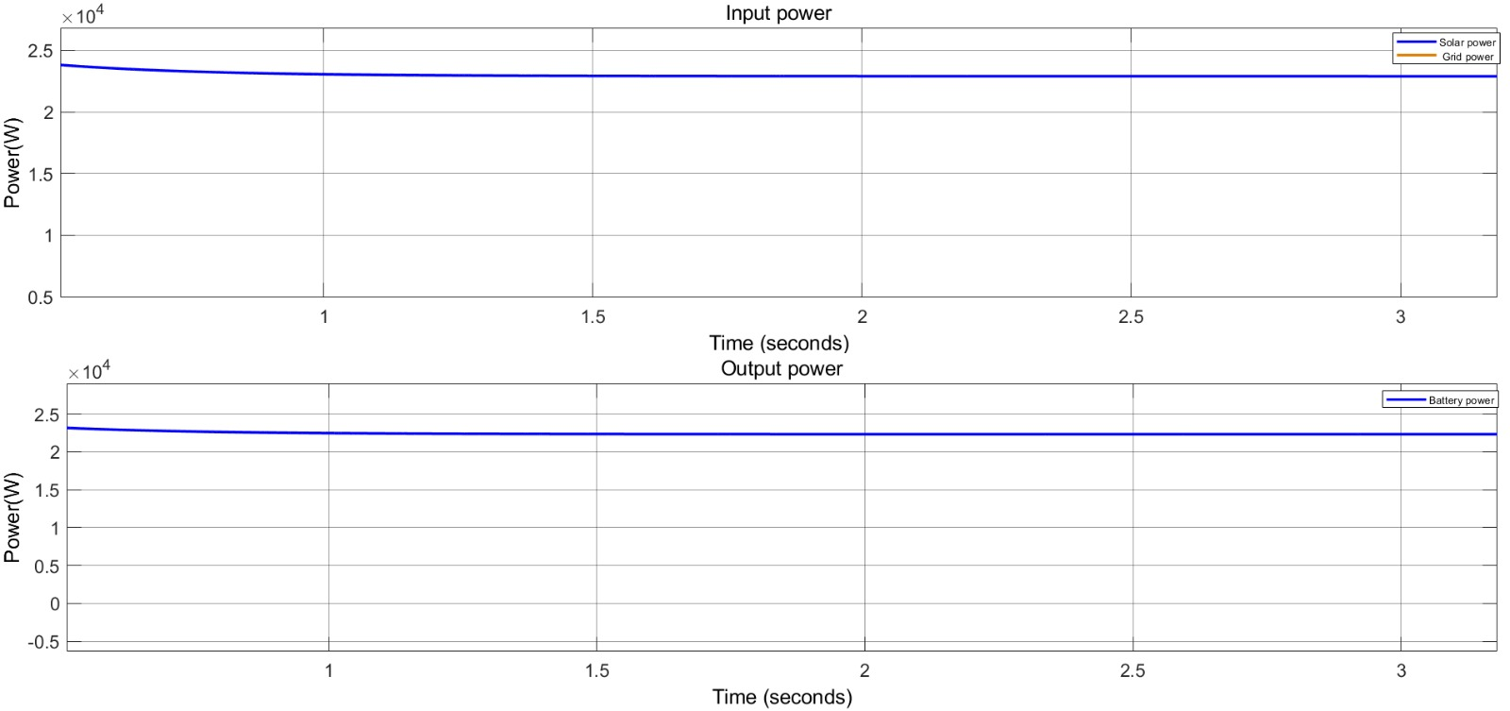
POWER GRAPHS OF MODE-2

Slide 51
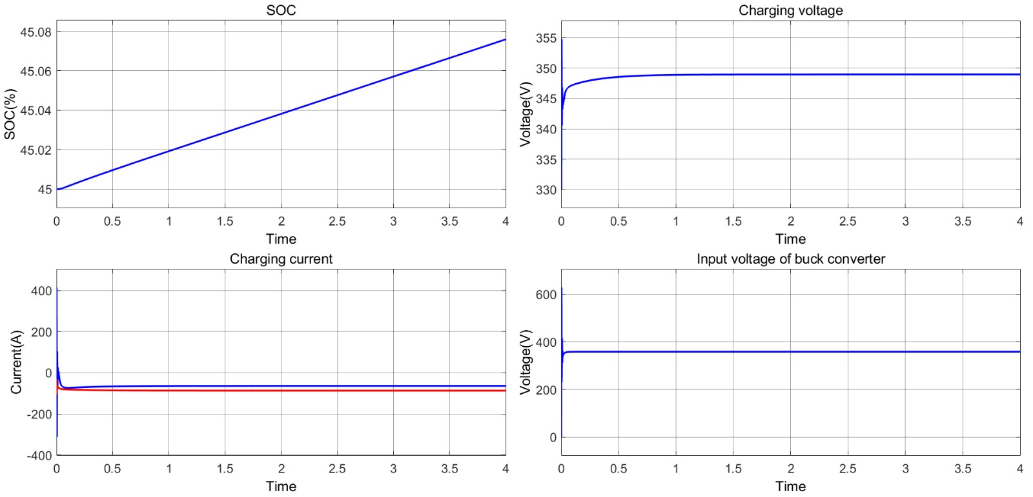
SOC, VOLTAGE ANALYSIS OF MODE-2

Slide 52
MODE-3 SOLAR PANEL + GRID TO EV BATTERY

Slide 53
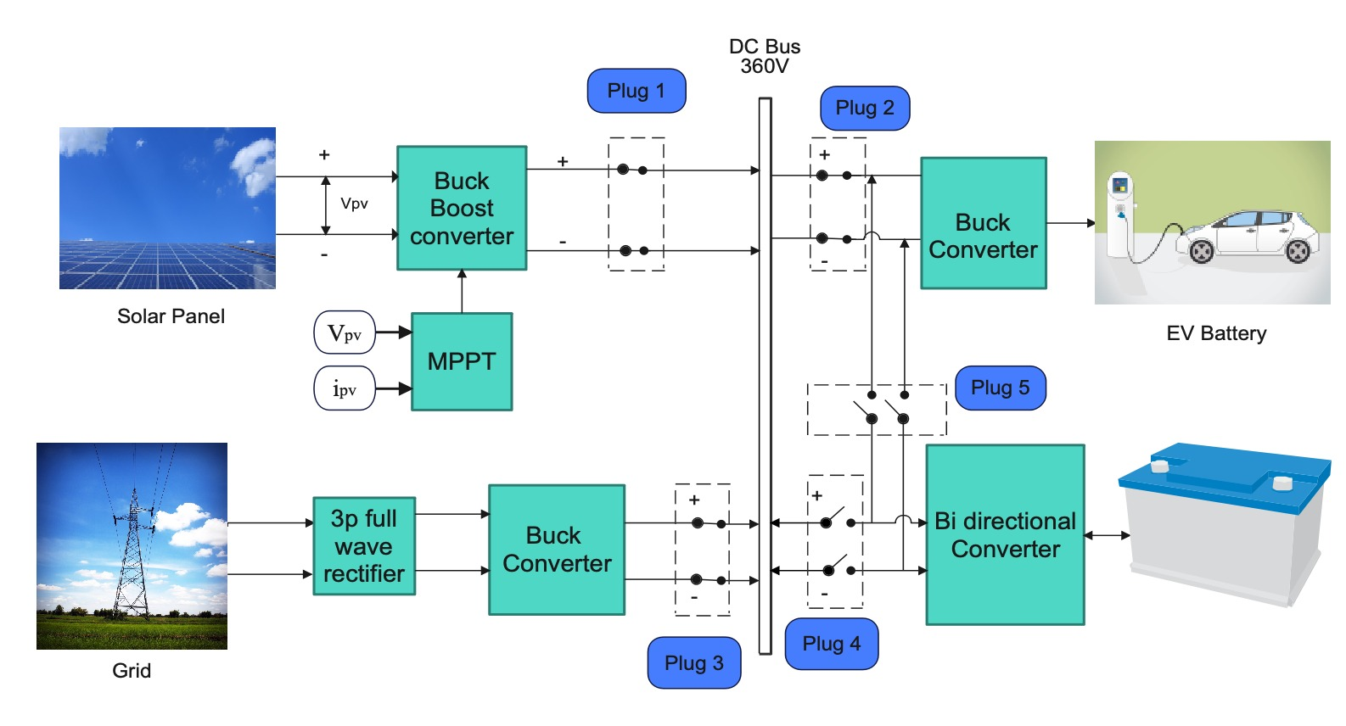
MODE-3 SOLAR PANEL + GRID TO EV BATTERY

Slide 54
MODE-3 SOLAR PANEL + GRID TO EV BATTERY

Slide 55
MODE-3 SOLAR PANEL + GRID TO EV BATTERY

Slide 56
MODE-3 SOLAR PANEL + GRID TO EV BATTERY

Slide 57
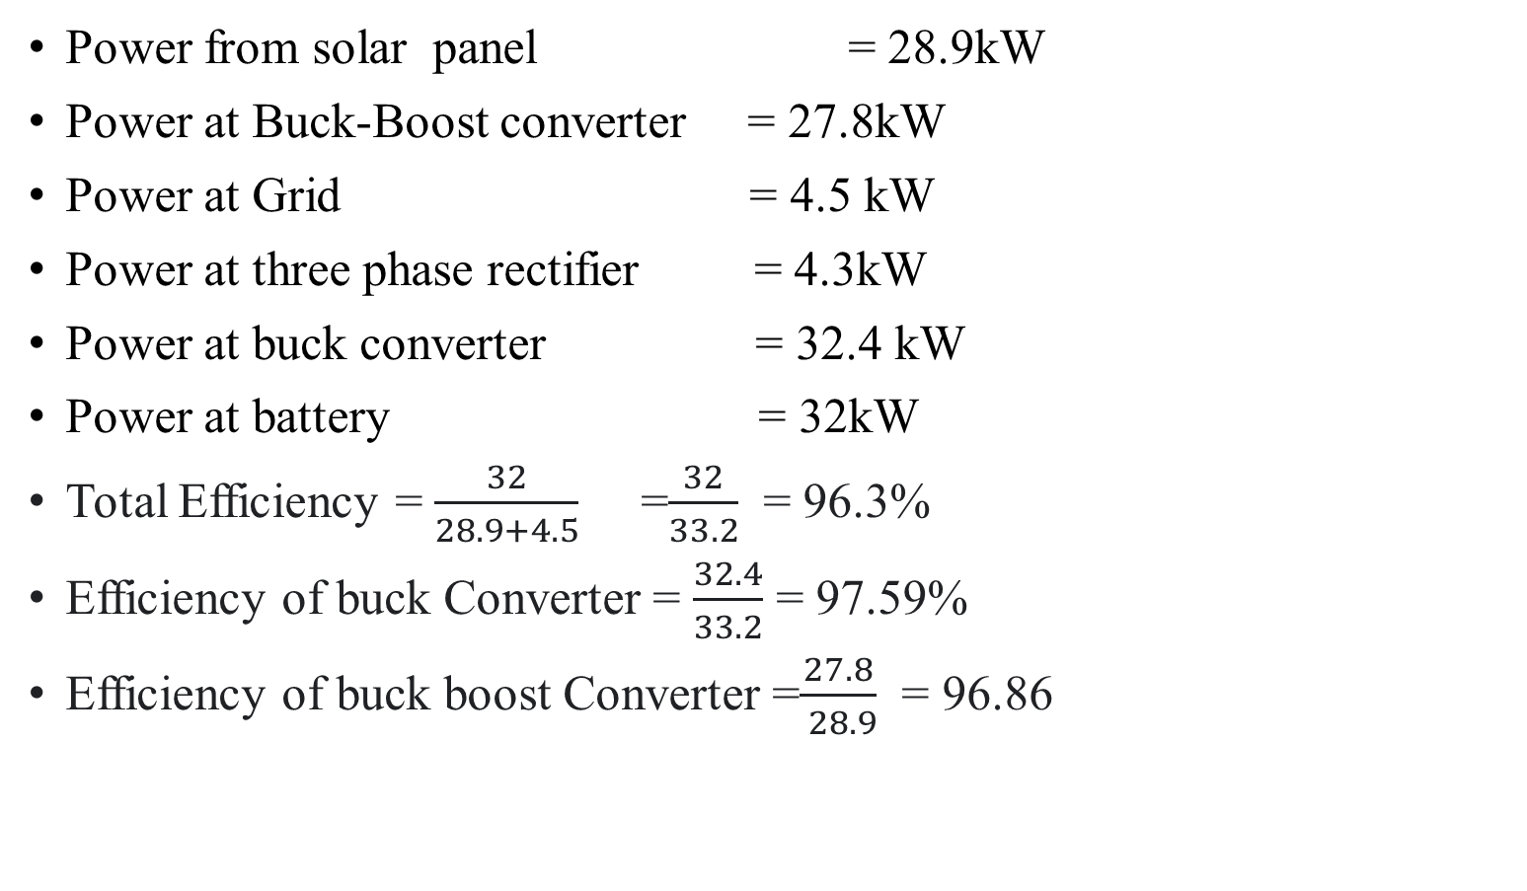
MODE-3 SOLAR PANEL + GRID TO EV BATTERY
Power from solar panel = 28.9kW
Power at Buck-Boost converter = 27.8kW
Power at Grid = 4.5 kW
Power at three phase rectifier = 4.3kW
Power at buck converter = 32.4 kW
Power at battery = 32kW
Total Efficiency = $\frac{32}{28.9+4.5}$ =$\frac{32}{33.2}$ = 96.3%
Efficiency of buck Converter = $\frac{32.4}{33.2}$ = 97.59%
Efficiency of buck boost Converter =$\frac{27.8}{ 28.9}$ = 96.86

Slide 58
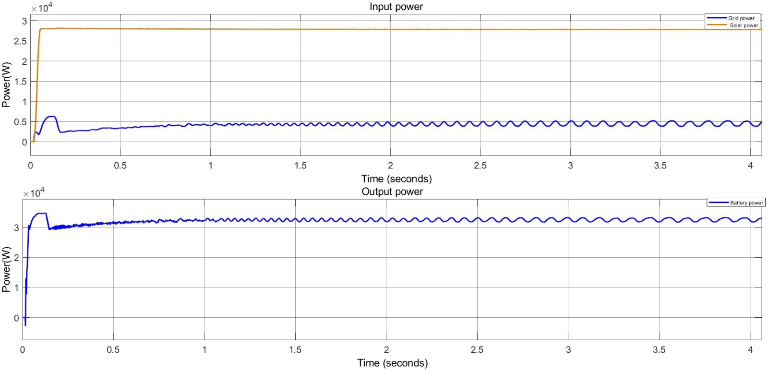
POWER GRAPHS OF MODE-3

Slide 59
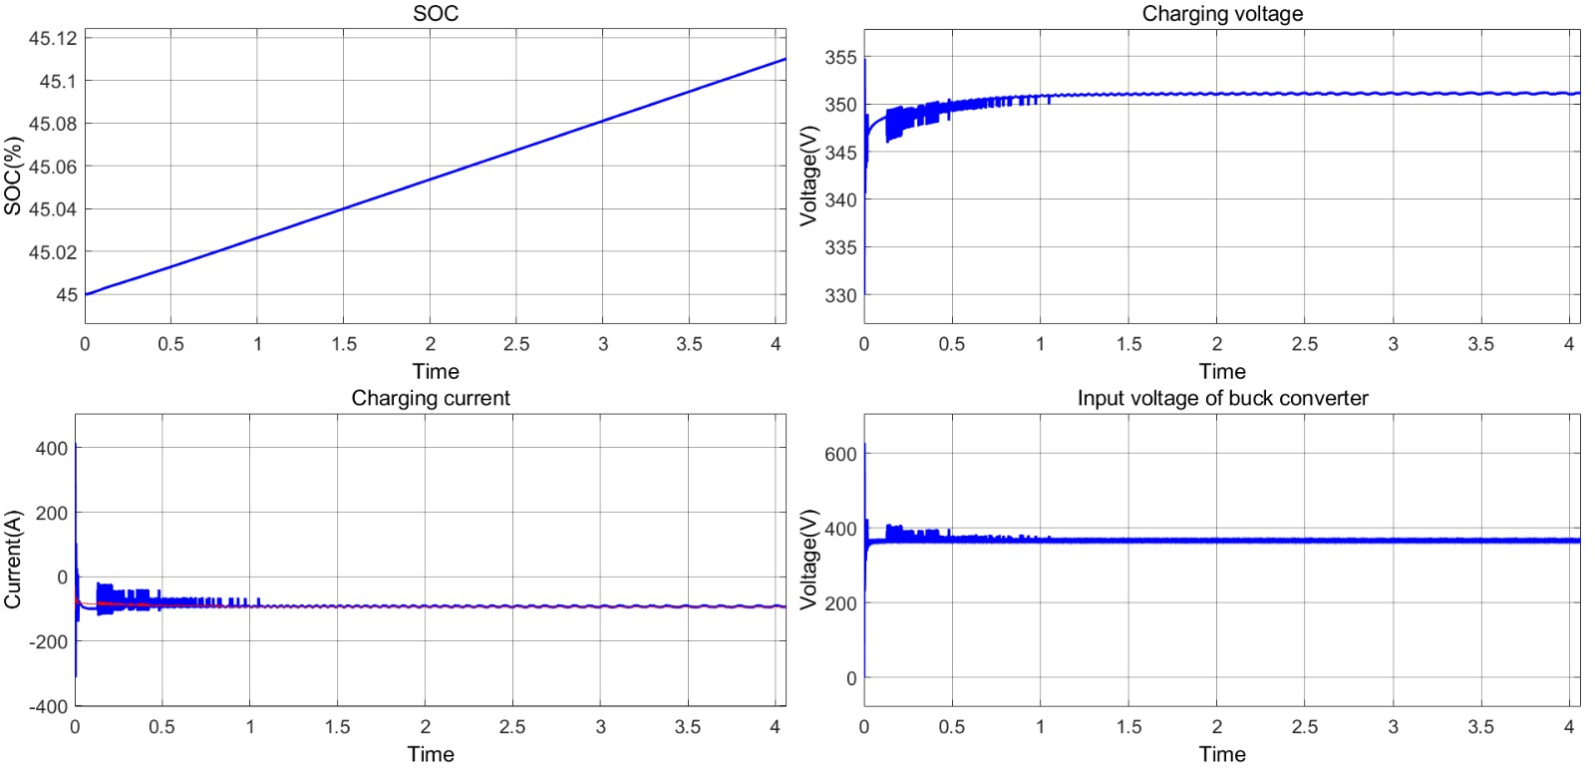
SOC, VOLTAGE ANALYSIS OF MODE-3

Slide 60
MODE-4 BACK UP BATTERY TO EV BATTERY

Slide 61
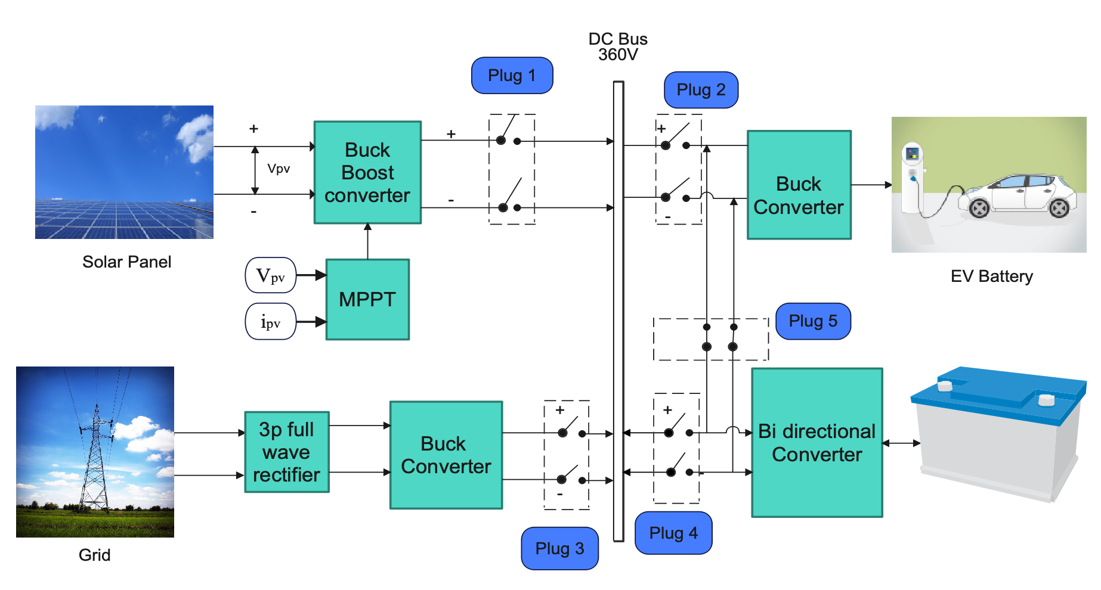
MODE-4 BACK UP BATTERY TO EV BATTERY

Slide 62
MODE-4 BACK UP BATTERY TO EV BATTERY

Slide 63
MODE-4 BACK UP BATTERY TO EV BATTERY
Bi Directional converter
Pin = 3454W
Pout = 3320W
Efficiency = 96.12%
Buck converter
Pout = 3210W
Pin = 3320W
Efficiency = 96.68%
P battery =3125W
Total efficiency =90.47%

Slide 64
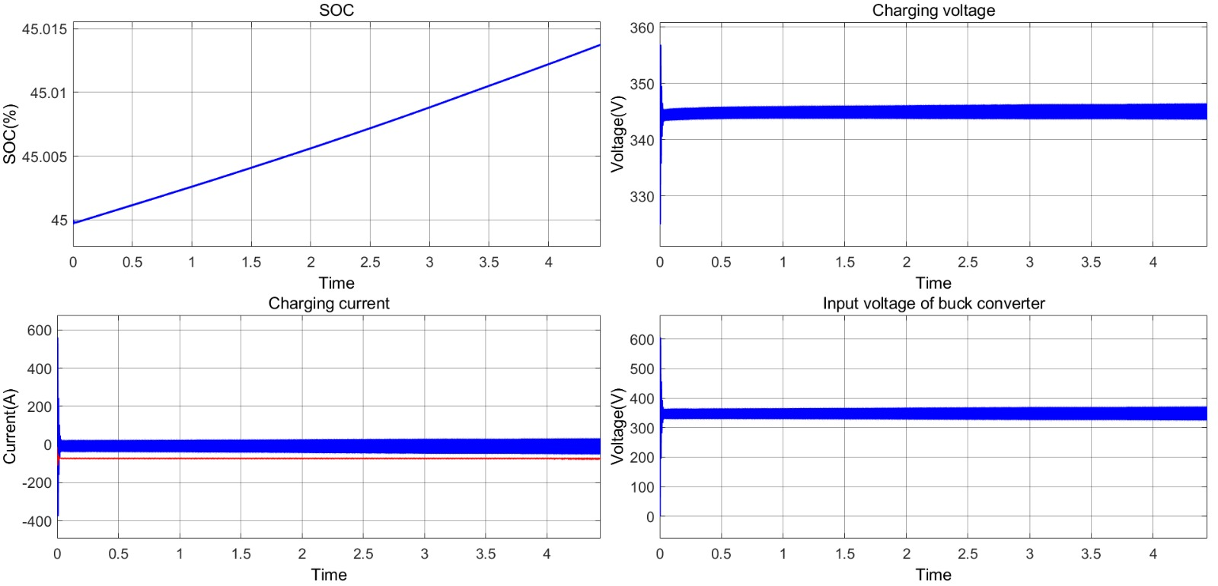
SOC, VOLTAGE ANALYSIS OF MODE- 4

Slide 65
MODE -5 SOLAR TO EV BATTERY & BACK UP BATTERY

Slide 66
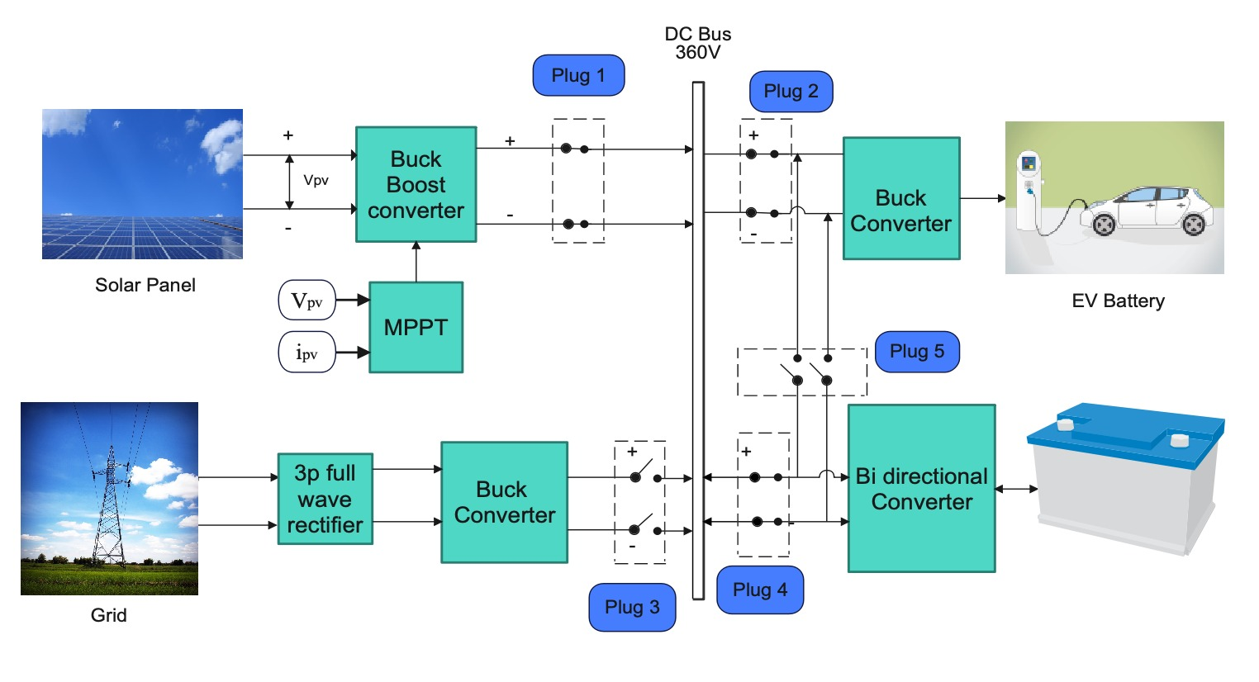
MODE -5 SOLAR TO EV BATTERY & BACK UP BATTERY

Slide 67
MODE -5 SOLAR TO EV BATTERY & BACK UP BATTERY

Slide 68
MODE -5 SOLAR TO EV BATTERY & BACK UP BATTERY

Slide 69
MODE -5 SOLAR TO EV BATTERY & BACK UP BATTERY

Slide 70
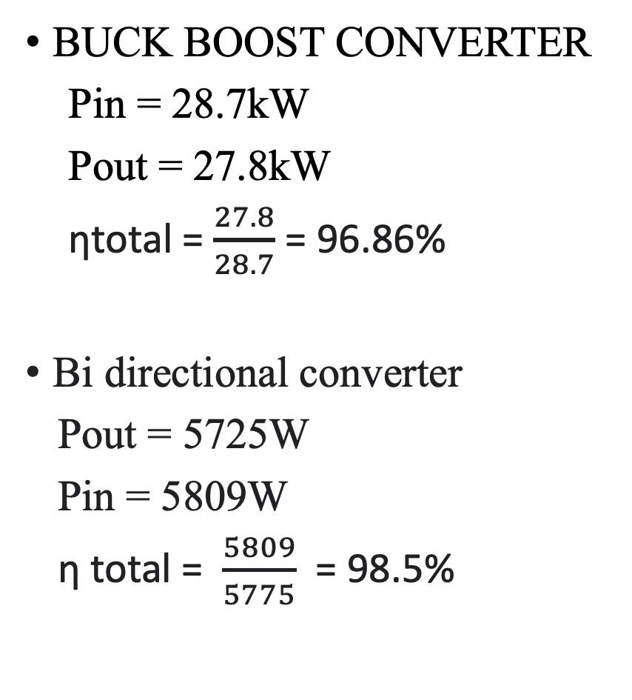
MODE -5 SOLAR TO EV BATTERY & BACK UP BATTERY
BUCK BOOST CONVERTER
Pin = 28.7kW
Pout = 27.8kW
ηtotal = $\frac{27.8}{28.7}$ = 96.86%
Bi directional converter
Pout = 5725W
Pin = 5809W
η total = $\frac{5809}{5775}$ = 98.5%

Slide 71

MODE -5 SOLAR TO EV BATTERY & BACK UP BATTERY
BUCK CONVERTER
Pin = 22kW
Pout = 21.3kW
ηtotal = $\frac{21.3}{22}$ = 96.81%
Car battery efficiency = $\frac{21.1}{28.7}$ = 95.9%
Backup battery Efficiency = $\frac{5.523}{5.725}$ = 96.4%

Slide 72
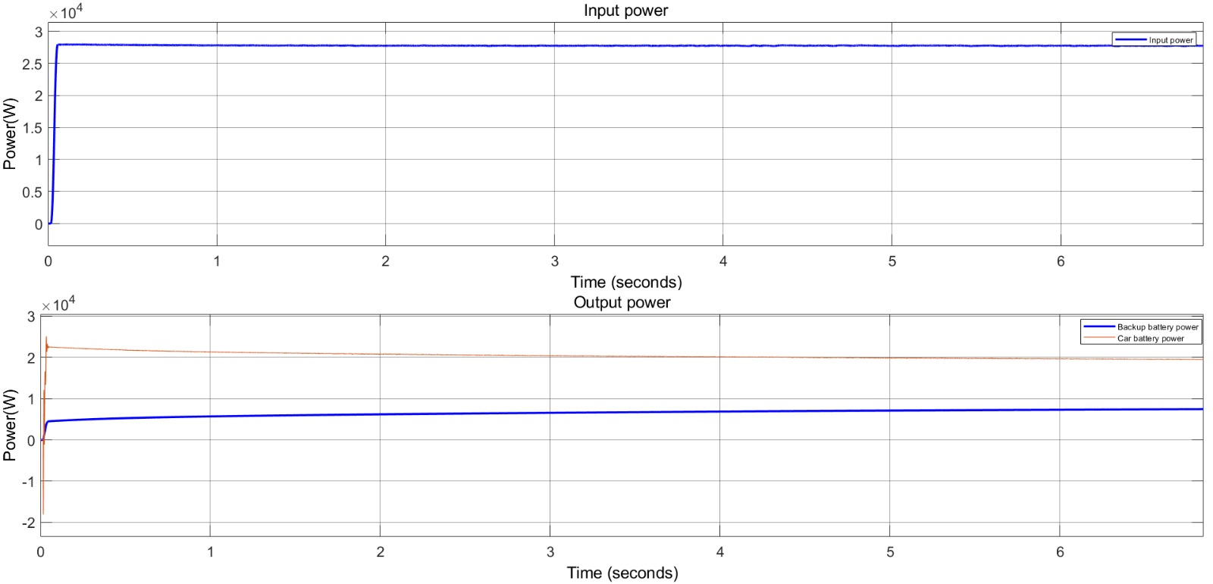
POWER GRAPHS OF MODE- 5

Slide 73
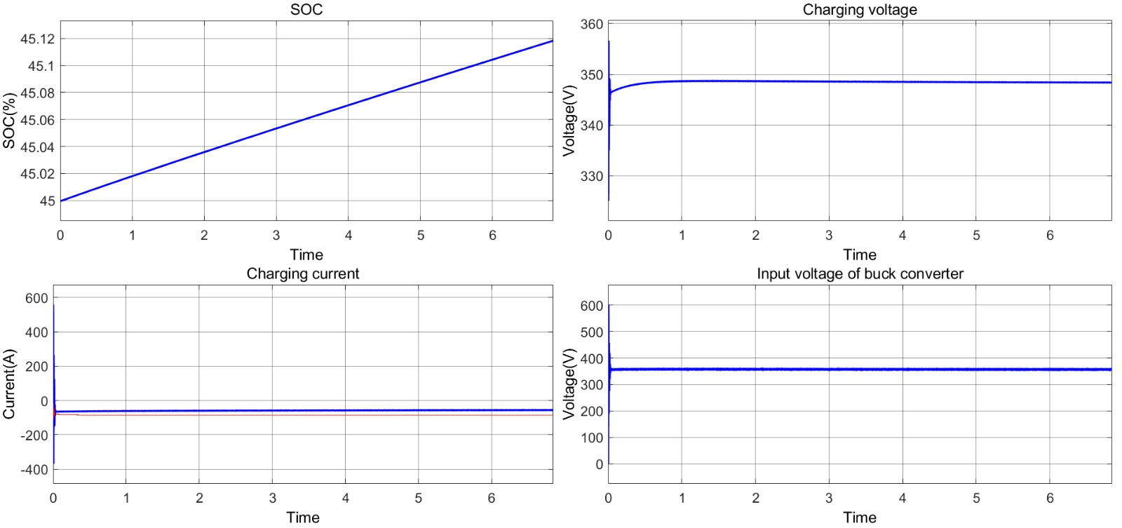
SOC, VOLTAGE ANALYSIS OF MODE-5

Slide 74
INFERENCE
A solar-grid hybrid charging station combines solar power with traditional grid electricity to charge vehicles, offering a sustainable and reliable energy source.
AC voltage is converted to DC voltage using three phase full wave Rectifier and step down by buck converter with efficiency of 97.3%
The solar panel energy efficiently powers the DC bus through a buck-boost converter with an impressive 94.4% efficiency, showcasing its high effectiveness in energy transfer.

Slide 75
CONCLUSION
The integration of a battery system over a DC link in a hybrid charging station represents a forward-looking solution that enhances energy management, improves grid reliability, and contributes to sustainability and energy savings. This technology paves the way for more efficient and adaptable electric vehicle charging infrastructure.

Slide 76
WORK IN PROGRESS
Vehicle-to-grid (V2G) is a technology that enables electric vehicles (EVs) to not only draw electricity from the grid for charging but also to discharge electricity back to the grid when needed. This bidirectional flow of electricity allows EVs to serve as temporary energy storage units, helping balance the grid by providing power during peak demand or times of strain. It's an innovative concept that contributes to a more efficient and resilient energy system.

Slide 77
TIME FRAME
Month and Year | Task to be Completed
August 2023 | Literature survey and problem identification.
September 2023 | Simulation of Grid connected EV charging scheme.
October 2023 | Simulation of the panel, bi directinal converter & EV charging scheme.
November 2023 | Integration of the whole charging station & analysis
December 2023 | Documentation.

Slide 78
TIME FRAME
Month and Year | Task to be Completed
January 2024 | Design of Vehicle-to-Grid Technology
February 2024 | Implementing Vehicle-to-Grid Technology
March 2024 | Design of solar energy from net metering
April 2024 | Implementing of solar energy from net metering
May 2024 | Integration and documentation

Slide 79
REFERENCES
[1] G. T. S. Rajan, V. Sivachidambaranathan, A. R. Babu, A. S. M. Antony, J. B. P. Glady and S. D. Sundarsingh Jebaseelan, "Hybrid Grid Charging Station for Electric Vehicle Using IoT," 2023 International Conference on Intelligent and Innovative Technologies in Computing, Electrical and Electronics (IITCEE), Bengaluru, India, 2023, pp. 528-532
[2] E. Saleh and N. Karami, "A Fast and Efficient MPPT Technique For PV Systems Using Divide and Conquer," 2023 Advances in Science and Engineering Technology International Conferences (ASET), Dubai, United Arab Emirates, 2023, pp. 01-06
[3] R. Madhumitha, P. Priya and S. Saravanan, "Hybrid Renewable Energy Based Electric Vehicles Charging Station," 2022 2nd International Conference on Advance Computing and Innovative Technologies in Engineering (ICACITE), Greater Noida, India, 2022, pp. 2348-2352.

Slide 80
REFERENCES
[4] A. Safaeinasab, H. S. Gohari and K. Abbaszadeh, "Design and Control of a Novel Multi-port Bidirectional Buck-Boost Converter Suitable for Hybrid Electric Vehicle Charging Stations," 2022 30th International Conference on Electrical Engineering (ICEE), Tehran, Iran, Islamic Republic of, 2022, pp. 1027-1032
[5] K. S. Vikas, B. Raviteja Reddy, S. G. Abijith and M. R. Sindhu, "Controller for Charging Electric Vehicles at Workplaces using Solar Energy," 2019 International Conference on Communication and Signal Processing (ICCSP), Chennai, India, 2019, pp. 0862-0866
[6] S. Palanidoss and T. V. S. Vishnu, "Experimental analysis of conventional buck and boost converter with integrated dual output converter," 2017 International Conference on Electrical, Electronics, Communication, Computer, and Optimization Techniques (ICEECCOT), Mysuru, India, 2017, pp. 323-329

Slide 81
REFERENCES
[7] Tata Nexon EV - Prime and Max. - Battery Design
[8] http://www.solarhub.com/product-catalog/pv-modules/3316-
A10J-M60-220-A10Green-Technology
[9] Buck Converter Design Tutorial | ElectronicsBeliever
[10] Inverting Buck-Boost Step by Step Design Guide (electronicsbeliever.com)

